Slide 1
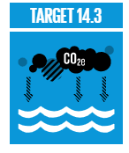
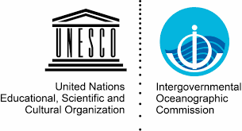
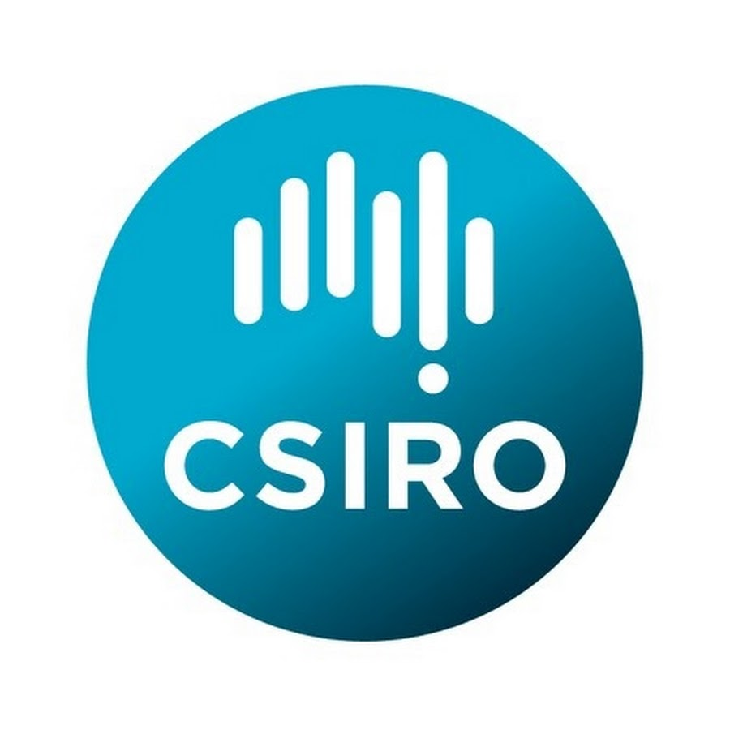
A closer look at the
Voluntary Commitments on Ocean Acidification
REDUCE
OCEAN ACIDIFICATION
Peter Swarzenski, IAEA, Monaco
Bronte Tilbrook, The Commonwealth Scientific and Industrial Research Organisation (CSIRO), Hobart, Australia
Trevor Eakes, Carolina Galdino, & Hasti Dessa, IAEA, Monaco
Kirsten Isensee, IOC-UNESCO, Paris, France
Lina Hansson, FPA2, Monaco
Notes:
This presentation is brief update on new and existing VCs on OA that were submitted for SDG 14.3.
I would like to acknowledge my co-focal point, Dr Bronte Tillbrook, CSIRO
And my team in MC, Trevor, Carolina and Hasti
as well as Kirsten Isensee (IOC)
and Lina Hansson, from Prince Albert Foundation 2

Slide 2
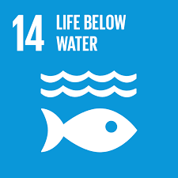
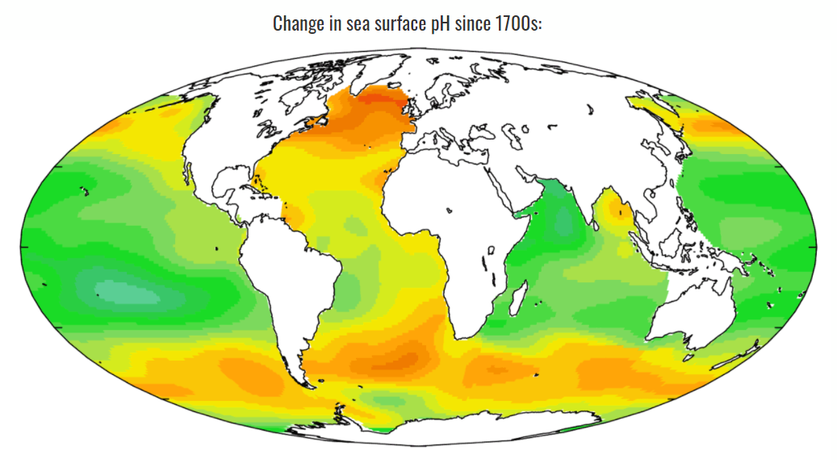
COA on Ocean Acidification
March 2021: 277/1642 VCs address SDG 14.3
Direct OA (80)
Primarily OA
REDUCE
OCEAN ACIDIFICATION
Only OA
Indirect (197)
https://www.oceanactionhub.org
Notes:
Out of the 1,642 VCs submitted as an outcome of the Ocean Conference, 277 address SDG 14.3 (one of the smaller COAs)
Out of these 277, we divided them into directly or indirectly focused on OA.
Example of direct: Specifically targeting OA, e.g. VCs collecting OA data, communicating on OA or building capacity to study OA
Indirect: addressing ocean health more broadly, e.g. VCs reinforcing or creating new MPAs, reducing fishing pressure, reducing pollution. Also VCs reducing CO2 (even if directly mitigating OA).
Of the 80 directly focusing on OA, 21 had OA as their ONLY focus

Slide 3
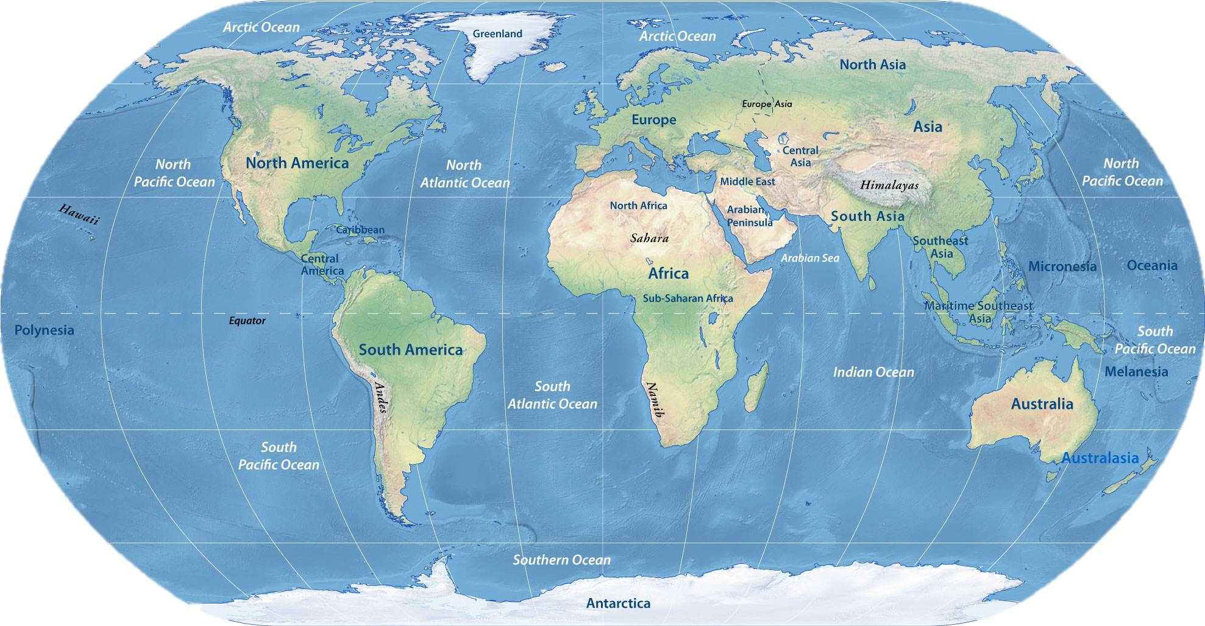
Geographic scope of OA VCs
Arctic Ocean
18 (7%)
North Pacific
58 (21%)
North Atlantic 79 (29%)
Global
132 (48%)
Indian Ocean 64 (23%)
South Atlantic 32 (12%)
South Pacific
50 (18%)
Southern Ocean
9 (3%)
Note: Many of the VC’s target more than one region
Notes:
Indian ocean is an even mix of capacity builders like TOF and the OA Africa Network, government organizations, and support for data projects in the region. Almost a 1/2 of VCs are global in scope. The analysis of 80 VCs of direct relevance show similar results to the indirect VCs. However, some small differences:
The direct VCs have a larger percentage in North Pacific & Arctic, and less in N Atlantic.
Underrepresented regions include the South Atlantic, South Pacific, and Arctic, despite known vulnerabilities of polar regions to OA.

Slide 4
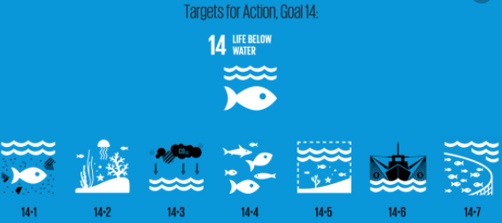
Direct OA VCs covering other SDG14 Targets
Increase scientific knowledge, research & technology for Ocean Health
Reduce marine pollution
Protect and restore ecosystems
Conserve marine areas
Sustainable use of marine resources (SIDS)
Sustainable fishing
Remove harmful fisheries subsidies
Small-scale fishers
Notes:
SDG 14.1-9 remake

Slide 5
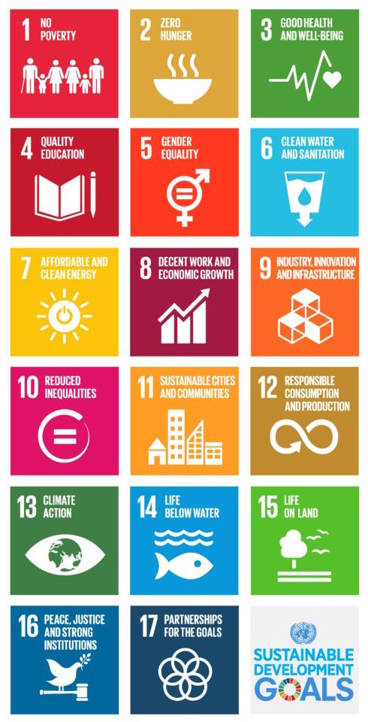
(%)
Notes:
As just presented, many VCs are in line with other SDG 14.3 targets, however it is also interesting to look at how these VCs fit with other Sustainable Development Goals.
Trends are similar for all VCs and the 61 with direct focus on OA. Here, only the results from the 61 are shown.
The main SDGs that share VCs with 14 are:
SDG 13 = Climate Action. This is to be expected, since OA and climate change are both consequences of CO2 emissions
SDG 17 = Partnership for the Goals, since the SDGs in general can only be realized with strong cooperation b/w groups

Slide 6
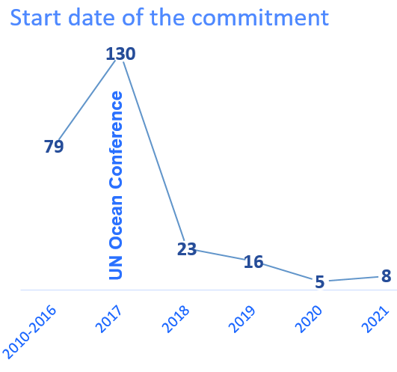
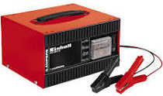
Brief overview ….
~20% of OA VCs were submitted since 2017, of which 40% are direct OA VCs
~50% of OA VCs are due to end before 2021
40% of OA VC have submitted progress reports and have been successfully implemented
Most progress reports for commitments are pending
Less than 20% of the submitted VCs have deliverables post-2020
We need to:
energize community to highlight its continuing achievements and…
… motivate further action
Notes:
Huge opportunity to reinvigorate the community
Blue Charter

Slide 7
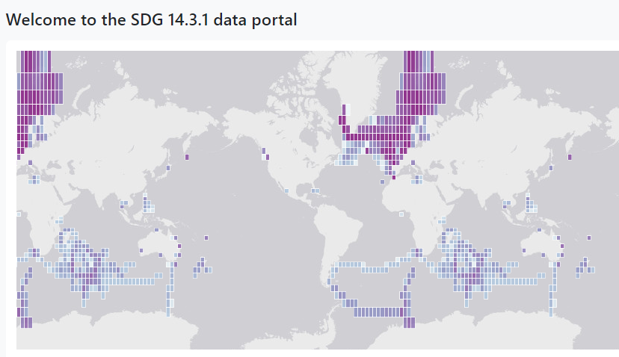
Some progress on deliverables:
OA Alliance and the Ocean Conservancy continue to develop their ocean action toolkit and engage OA community
GOA-ON: adds an Arctic Hub to its network and continues to organize large virtual meetings and seminars
IOC-UNESCO Member States reporting on 14.3.1 grown from 8 to 30 in 2020
The Ocean Foundation is conducting trainings in West Africa, the Western Pacific
OA-ICC capacity building / trainings / Comms
https://oa.iode.org/
This data portal allows for the submission >> validation >> sharing of OA data
Success story: COL, CUB and MEX (2020)

Slide 8
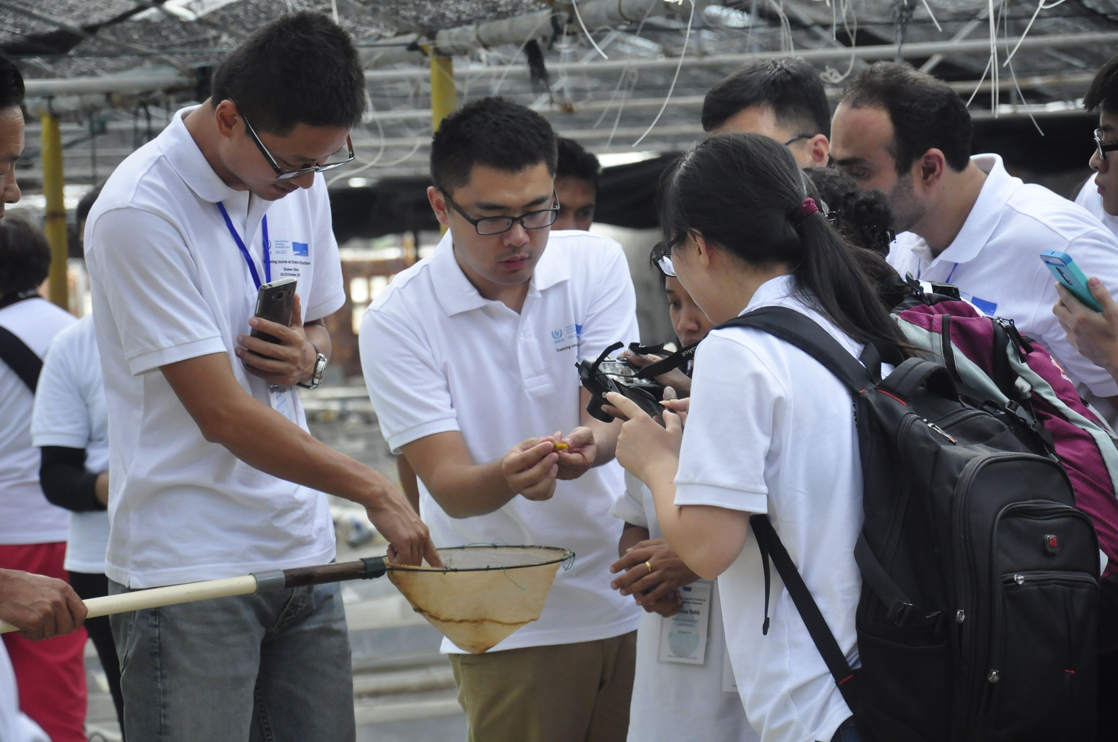
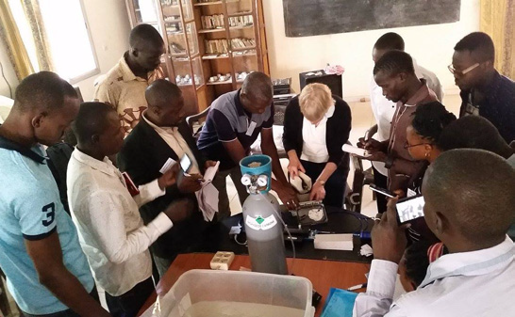
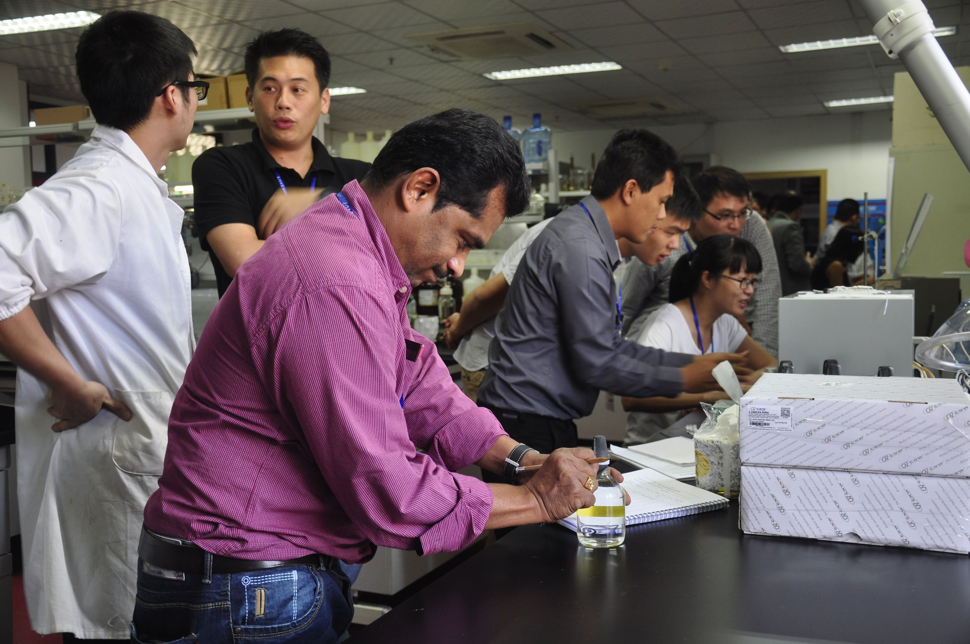
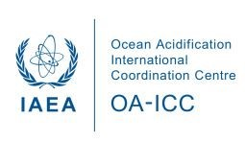
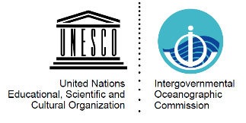
Examples of OA Voluntary Commitment: OA-ICC w/ its partners
Since 2012: 856 capacity building opportunities & 749 scientists from 107 MSs

Slide 9
Next steps
Challenges:
No in-person meetings >> approach to capacity transfer has to be re-thought
Opportunities:
New opportunities for inclusive participation
Reduced carbon footprint
Highlight OA success stories
Follow-up on existing VCs and encourage new submissions
Pending global OA programme within the Ocean Decade
Upcoming COA OA webinar(s)

